Slide 1
Negative Externalities
Steven Suranovic
George Washington University

Slide 2
Externality Definition
An externality occurs when a production or consumption activity has an effect external to the market, that is, an effect on others not participating in the market.
The effects can be negative or positive
The cause can be production or consumption or both
Externality effects are not a part of perfect competition, hence they represent a market imperfection.

Slide 3
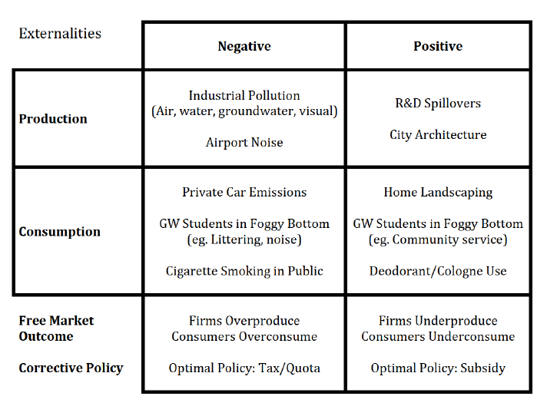

Slide 4
Negative Externalities
A negative externality effect that is uncorrected will irritate, or injure or kill, others who had no role in the activity
Polluters are not good neighbors; they sometimes don’t consider or care about how their activities affect others
Being a good neighbor implies being willing to work towards a compromise solution

Slide 5
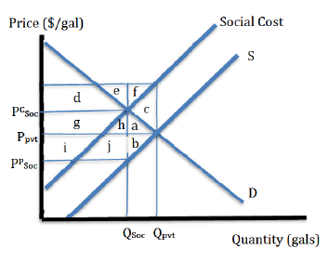
Negative Externality Case
Consider a market for gasoline
The free market, or private, outcome occurs at price P_{pvt} and quantity Q_{pvt}
Suppose consumption of gasoline causes negative external effects (pollution)
Let Social Cost = Pvt MC + Externality costs
The vertical distance between SC and S is the externality cost per unit consumed.

Slide 6
Negative Externality Case
The Social Cost function takes all costs into account
Intersection of marginal social cost with the demand curve, representing marginal benefit, determines the socially optimum output level, Q_{soc}
Note that Q_{soc} < Q_{pvt} which means that private, free market, decisions will result in overproduction and a reduction in economic efficiency

Slide 7
Negative Externality Case
The government can achieve the social optimum with a tax that will reduce consumption to Q_{soc}
Set the tax T = P^{C}_{soc} – P^{p}_{soc}
Because this is the tax rate needed to get the quantity to Q_{soc}
Consumer price rises → demand falls
Producer price falls → supply falls

Slide 8
Negative Externality Case
Welfare Effects
Externality Effect Before the tax
- (d + e + f + g + h + a + c)
Externality Effect After the tax
- ( d + e + g + h)
ΔExt Eff = + f + a + c

Slide 9
Negative Externality Case
Welfare Effects
ΔCS = - (g + h + a)
ΔPS = - (i + j + b)
ΔGR = + (g + h + i + j)
ΔExt Eff = + (f + c + a)
ΔMW = f + c – b = f + c – f = + c

Slide 10
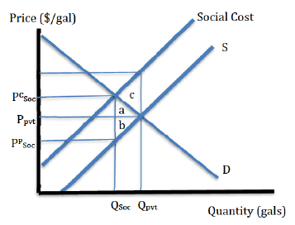
Negative Externality Case
Welfare Effects
Although the tax causes deadweight losses（a+b）the benefit created by reducing pollution costs outweighs the tax inefficiency and causes a rise in market welfare (+c)
In other words, a government tax can raise economic efficiency when it corrects for a negative externality
Also means the free market outcome is inefficient.

Slide 11
Effects of Overtaxation
Although a tax on polluting activities can cause a welfare improvement, getting it right depends on measuring the costs and benefits accurately so one knows what the optimal tax would be
Consider the effects of a tax set too high
Set t₂ > t_{opt}

Slide 12
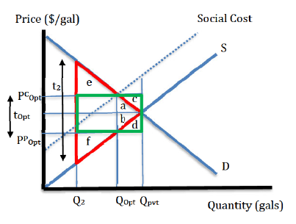
Overtaxation Case
Welfare Effects of t_{opt}
DWL = - (a + b)
ΔExt Eff = + (a + b + c + d)
ΔMW = + c + d
Welfare effects of t₂
DWL = - red triangle
ΔExt Eff = + green rectangle
ΔMW = c + d – (e + f)

Slide 13
Overtaxation Case
Note that overtaxation reduces market welfare in this case
Implies that the optimal level of pollution is not zero
Those affected by pollution would surely prefer no pollution at all, but that would be inefficient in this case because the damage caused to firms and consumers is greater than the damage caused by pollution
Optimal solution balances the costs of pollution with the benefits of providing the product

Slide 14
Case of Optimal Zero Pollution
If the costs of pollution are sufficiently high, then the optimal level of pollution may be zero
An example might be chemicals in groundwater caused by production that would cause death to all water consumers in the area
Demonstrated in next slide.

Slide 15
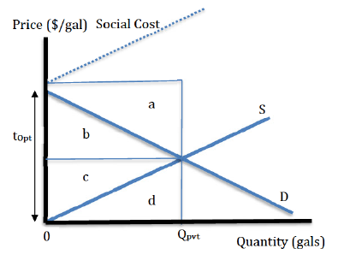
Case of Optimal Zero Pollution
t_{opt} is set such that production and consumption eliminated
ΔCS = - b
ΔPS = - c
ΔGR = 0
ΔExt Eff = + a + b + c + d
ΔMW = + a + d

Slide 16
Case of Optimal Zero Pollution
An alternative policy is a regulation such that Q = 0 (a production ban)
Same welfare effects as before, if producers and consumers comply
Cheating is highly profitable since a small amount can be sold at a high price
Thus, high penalties are generally used to induce compliance

Slide 17
Application: Drugs Policy
Consider a market for illegal drugs
Marijuana, heroin, Meth, etc
Proponents and opponents differ on extent of the social cost
Illegality inspires high profits for cheaters
High penalties in attempt to dissuade often leads to high incarceration rates
Drug legalization may raise usage but prevents other social damage

Slide 18
Case of Global Climate Change
Fossil fuel usage causes climate change which may have negative impact on human population
Hence, fossil fuel usage has a negative externality effect in both production and consumption
Can correct the problem with an appropriate optimal tax or quota on fossil fuel usage
But, the problem here is very complicated ….

Slide 19
Case of Global Climate Change
What are the benefits of fossil fuel usage?
FFs provide for the majority of our energy usage today, including electricity, transportation, heating, production, electronics, etc.
Despite being a non-renewable resource, there is more FFs available today than ever before
Many companies and countries control enormous reserves that can be tapped for future usage and profit
Consumption demand drives production
Unhelpful to fault producers over consumers

Slide 20
Case of Global Climate Change
What are the costs of fossil fuel usage?
Larger damage-causing storms, rising sea levels and coastal flooding, more droughts causing fires and reducing agricultural production
When do the costs of fossil fuel usage occur?
Mostly in the future; one cannot attribute any current event to the effects of climate change; instead one can only look at patterns over long periods
→ no one person can ever experience climate change effects directly … must accept the science

Slide 21
Case of Global Climate Change
Who will experience the costs of fossil fuel usage?
People living 50-100 years from now
People in coastal communities
People in hurricane/typhoon/cyclone prone areas
People in developing countries more so than in the US
Can we measure the costs of climate change?
Not reliably .. There is too much complexity and the effects stretch too far in the future
Estimates can be made … but they are no more than educated guesses

Slide 22
Case of Global Climate Change
The issue is a collective action problem
Every country’s carbon emissions affects the whole world’s climate outcome
Free riding is a problem which if not solved means some countries may not participate in the effort
Some country’s efforts may cause more short-term harm than long-term benefit for themselves (eg. in developed countries)
Should contributions to the effort be based on current emissions or lifetime emissions?
Eg. China is biggest single emitter today, but the US is the biggest emitter historically

Slide 23
Case of Global Climate Change
How to determine the optimal solution?
What are the costs of various options?
How much would it cost to reduce fossil fuel usage? How much reduction is necessary?
How much would it cost to adapt to the consequences?
How much would it cost to geo-engineer a decrease in global temperatures?
How much would it cost to develop alternative non-carbon energy sources?
How long would it take for any of these options above?

Slide 24
Case of Global Climate Change
Global Climate change is an global externality problem
It is a collective action problem
The current equilibrium is like being stuck in a prisoner’s dilemma problem
It poses a severe measurement problem
The science of climate change may be known, but the economics of climate change is far from being known.

Slide 25
Case of Global Climate Change
Tales of Two Climate Change Evaluations
The Uninhabitable Earth – David Wallace-Wells
It is worse, much worse, than you think. If your anxiety about global warming is dominated by fears of sea-level rise, you are barely scratching the surface of what terrors are possible—food shortages, refugee emergencies, climate wars and economic devastation.
False Alarm – Bjorn Lomberg
Enough, argues bestselling author Bjorn Lomborg. Climate change is real, but it’s not the apocalyptic threat that we’ve been told it is. Projections of Earth’s imminent demise are based on bad science and even worse economics. In panic, world leaders have committed to wildly expensive but largely ineffective policies that hamper growth and crowd out more pressing investments in human capital, from immunization to education.

